Slide 1


Tracking and Analyzing Route Deviations for Uber Drivers
Presented By:
Ashish Chincholikar
Suraj Chothe
Under the Guidance of :
Dr. R. B. Naik

Slide 2

Business Understanding
Develop a system that can analyze historical trip data of Uber drivers to identify instances where drivers have deviated from their assigned routes. The system will detect these deviations, quantify them against established thresholds, and calculate appropriate fines for drivers who exceed the allowable limits.
Objectives :
To boost overall business performance while maintaining fairness and trust between the Drivers and the Company.
To Calculate the Dead Kilometers and Penalizes the Drivers if it exceeds a certain limit.
Maximize :
The accuracy of Dead Kilometers detection.
Driver Retention
Profit Maximization
Customer Satisfaction
Minimize :
Dead Kilometres
Operational Costs : The cost associated because of Dead kilometres.

Slide 3
Overview of Challenges Faced by uber
Concept of Dead Kilometers:
Definition: Dead kilometers refer to the distance traveled by a driver between the drop-off location of one trip and the starting point of the next trip without a passenger. These kilometers represent inefficient utilization of resources, as the driver is not earning during this travel time.
Cause: This typically occurs when a driver finishes a trip and needs to find another ride, leading to an idle time where fuel is consumed without generating revenue.

Slide 4

Technologies used
*
Python Libraries
*
Pandas: For data manipulation and analysis.
Matplotlib: For plotting graphs and visualizations.
Gmplot: A library for plotting data on Google Maps, useful for geospatial visualizations.
Geopy: A library used for calculating distances between geographic coordinates.
Os: Used for interacting with the operating system, such as accessing file paths.

Slide 5

Data Set & Data Preprocessing
1
2
3
Data Transformation
Data Cleaning
EDA : Exploratory Data Analysis
Transform the data into a format suitable for analysis, such as converting the features into appropriate datatypes
Remove incomplete or inaccurate data entries, such as missing GPS coordinates or unrealistic timestamps.
Analyze and visualize the Trends from the Data , with the help of different graphs and histograms.

Slide 6
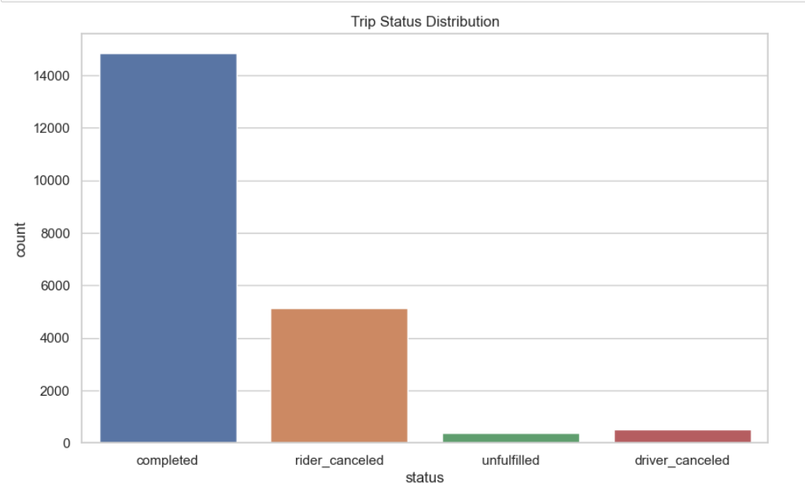
Visualizations :

Slide 7
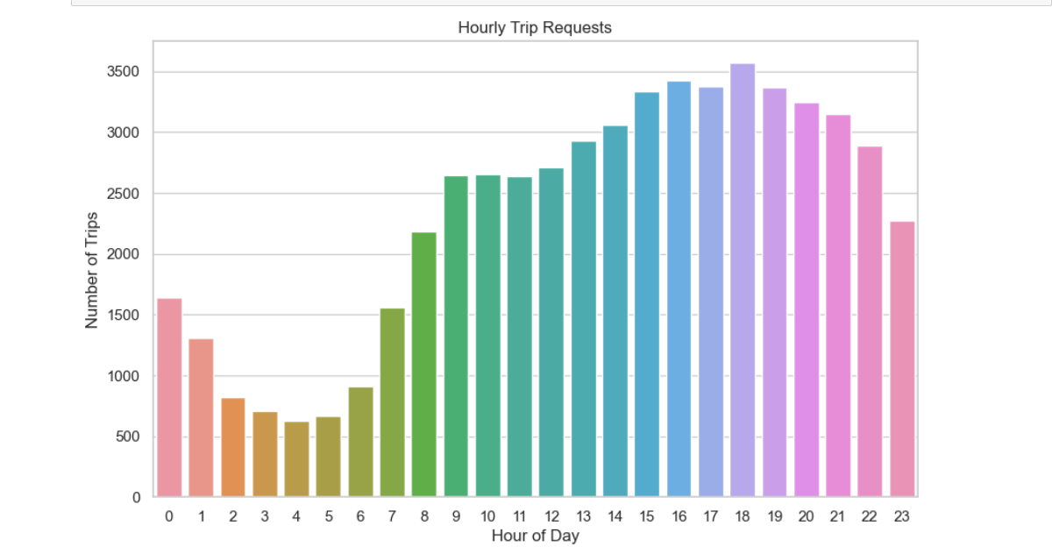

Slide 8
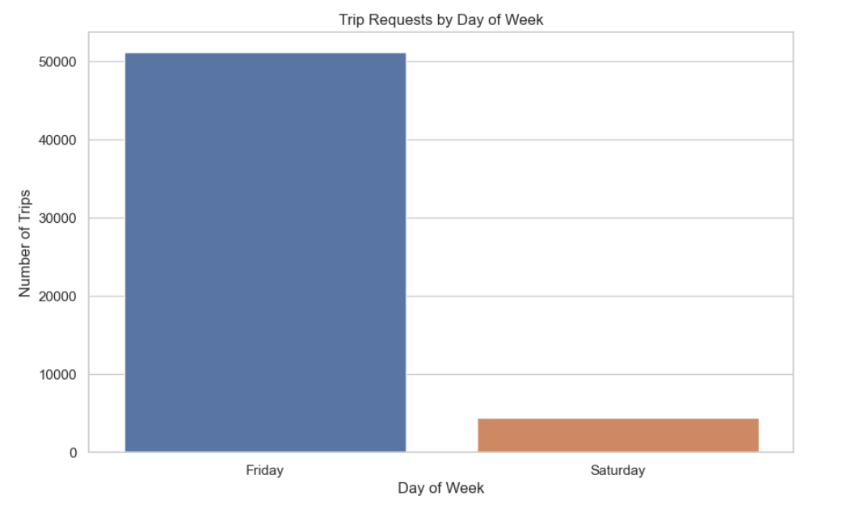

Slide 9
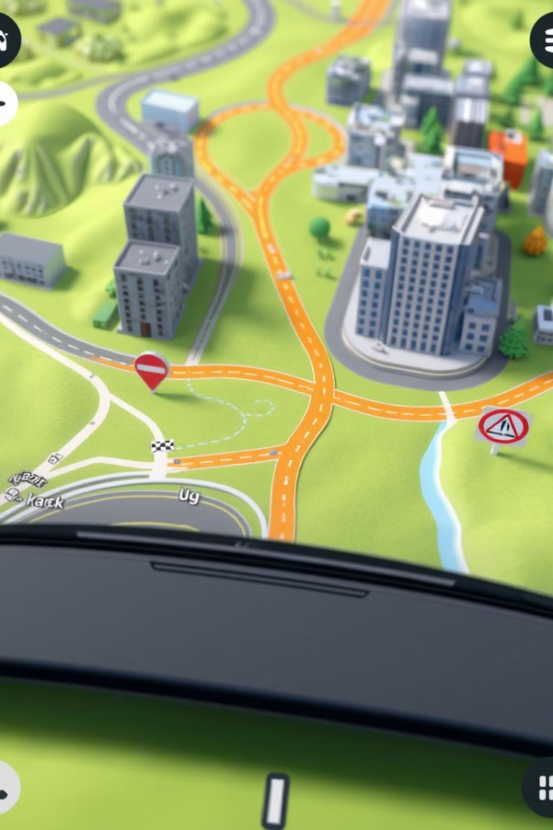




Mapping Driver Paths
Historical GPS data will be used to reconstruct the routes taken by drivers, providing a visual representation of their travel paths.
Save Driver-Specific Data as CSV:
Create a directory and save the information
Of each driver in a csv file.
Route Visualization on Google Maps:
Initializes a Google Map centered at the driver’s first trip coordinates.
Plots the trip paths using blue lines and marks the start and end points
Calculate Distance
Draws red dotted lines to indicate movement between trips.
Calculates distances between consecutive trips and applies fines if necessary.

Slide 10



Fines and Penalties
The system will calculate fines based on the severity
of deviations exceeding thresholds by measuring the distance
Between the consecutive trips.
No Offense
A warning message can be sent to the driver with a description of the deviation and a reminder of the established thresholds.
Offenses
Fines are calculated based on the severity of the deviation,
with increasing fines for repeated offenses.

Slide 11
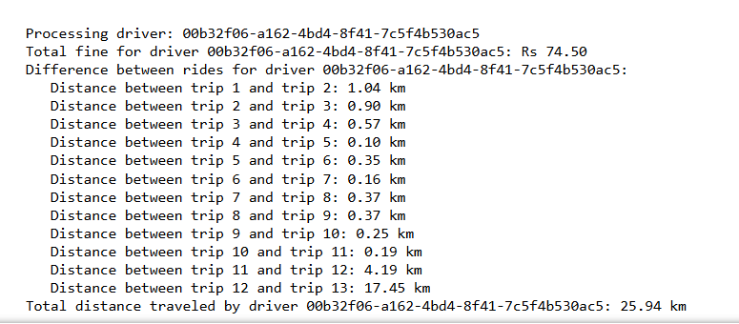
Results

Slide 12
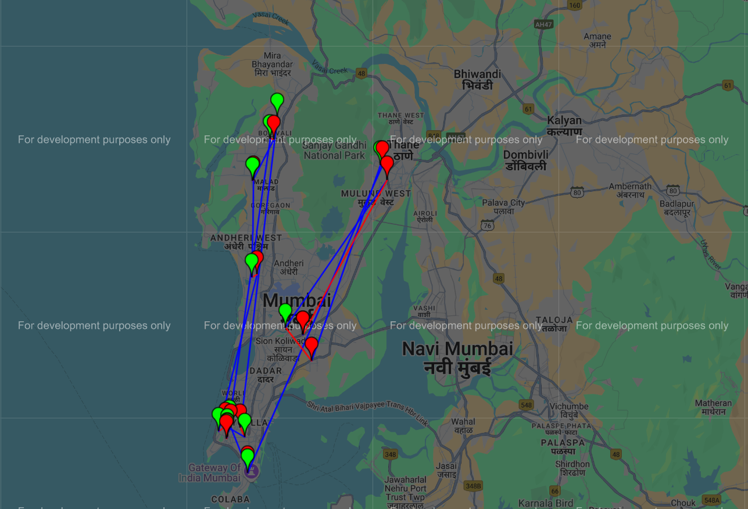

Slide 13




Conclusion and Next Steps
This project aims to improve rider experience and driver accountability by analyzing historical trip data and implementing a fair and transparent system for identifying and addressing route deviations.
Real-Time Implementation
Explore the feasibility of integrating real-time data into the system for more accurate and timely deviation detection.
Driver Feedback
Gather feedback from drivers on the system's effectiveness and identify areas for improvement.
Further Optimization
Continue refining the algorithms and thresholds to ensure accuracy and fairness in identifying and penalizing
route deviations.

Slide 14


